Slide 1
Computer Science Research
Prof. Dr. Vasilios Andrikopoulos
Software Engineering, Bernoulli Institute
v.andrikopoulos@rug.nl
Notes:
Welcome to the Bernoulli Institute!

Slide 2
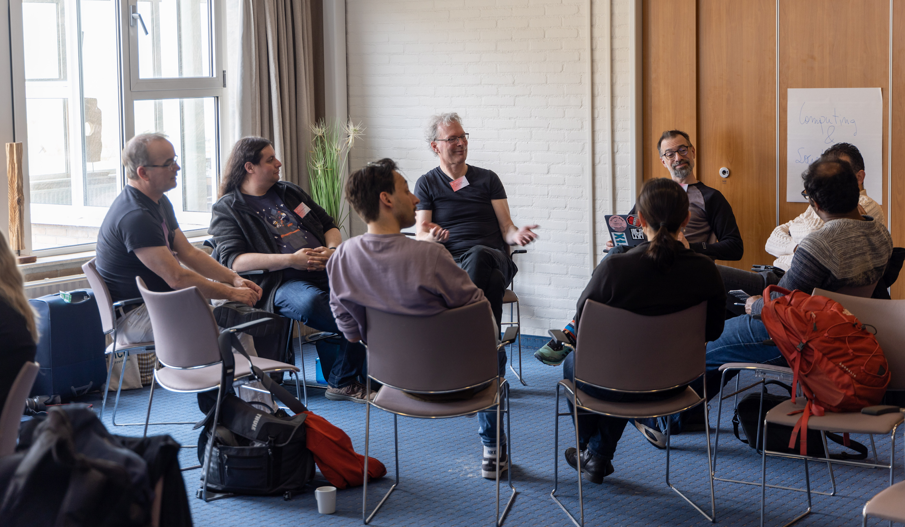
Scientific challenges
Complex systems
Understanding, predicting and controlling variations of systems and their geometry
Mathematical foundations &
applications
Digital & software systems and technologies
Cyber-physical systems
Human & computational cognition
Notes:
All 15+ research groups participate in this research

Slide 3
Scientific challenges
Complex systems
Understanding, predicting and controlling variations of systems and their geometry
Mathematical foundations &
applications
Digital & software systems and technologies
Cyber-physical systems
Human & computational cognition
Notes:
All 15+ research groups participate in this research

Slide 4
Digital & software systems and technologies
Software systems are undisputedly essential to society
Focus on building scalable, adaptable, and distributed software systems
By providing the right engineering tools and fundamental concepts, algorithms and design principles
By ensuring their sustainability
By making them easy to use by non-experts: e.g. Software Systems for AI and Data Science and AI for Software Systems, scientific computing, etc.
Approaches used based on fundamental research and engineering approaches
Under consideration of contemporary technological developments: AI and ML, data-driven approaches, Cloud computing, Service orientation
Notes:
1 NWA ORC; 1 Open Competition M; 1 NWO Smart Industry, I Open Competition M2 sustainable software architectures , KDT JU AIMS5.0 AI enabled sustainable Manufacturing and Value Chains, business processes and logistics, healthcare. Feringa Impact Award of Digital Forensics

Slide 5
Digital & software systems and technologies
Software systems are undisputedly essential to society
Focus on building scalable, adaptable, and distributed software systems
Engineered following systematic methodologies
Reliable and sustainable
Easy to use by non-experts
Building on both fundamental research and engineering principles
Open challenges
Increasingly important role of AI in software construction
Principled design and specification of systems
Communication of results
Notes:
1 NWA ORC; 1 Open Competition M; 1 NWO Smart Industry, I Open Competition M2 sustainable software architectures , KDT JU AIMS5.0 AI enabled sustainable Manufacturing and Value Chains, business processes and logistics, healthcare. Feringa Impact Award of Digital Forensics

Slide 6
Computer Architecture
CONTENT
Notes:
1 NWA ORC; 1 Open Competition M; 1 NWO Smart Industry, I Open Competition M2 sustainable software architectures , KDT JU AIMS5.0 AI enabled sustainable Manufacturing and Value Chains, business processes and logistics, healthcare. Feringa Impact Award of Digital Forensics

Slide 7
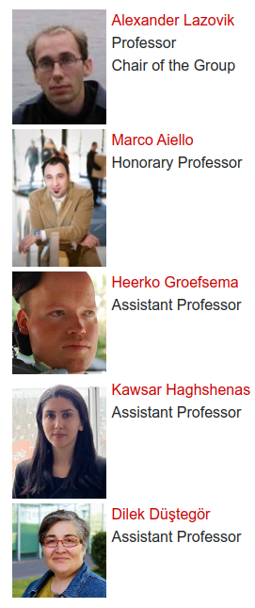
Distributed Systems
Research areas
Adaptive and Scalable Infrastructure for Distributed AI
Digital Twin for Smart Systems and Environments
Software Defined Networking and Network Function Virtualization
Sustainable and Green Computing
Machine Learning for Computer System Optimization
Business Process Management and Verification
Practical / Societal Impact:
Smart Industry and Internet of Things
Energy Efficiency and Water Management
Foundations of Computing on Smart Materials
keywords: big data, cloud services, digital twin, smart environments, data science and data engineering, distributed AI
Notes:
1 NWA ORC; 1 Open Competition M; 1 NWO Smart Industry, I Open Competition M2 sustainable software architectures , KDT JU AIMS5.0 AI enabled sustainable Manufacturing and Value Chains, business processes and logistics, healthcare. Feringa Impact Award of Digital Forensics

Slide 8
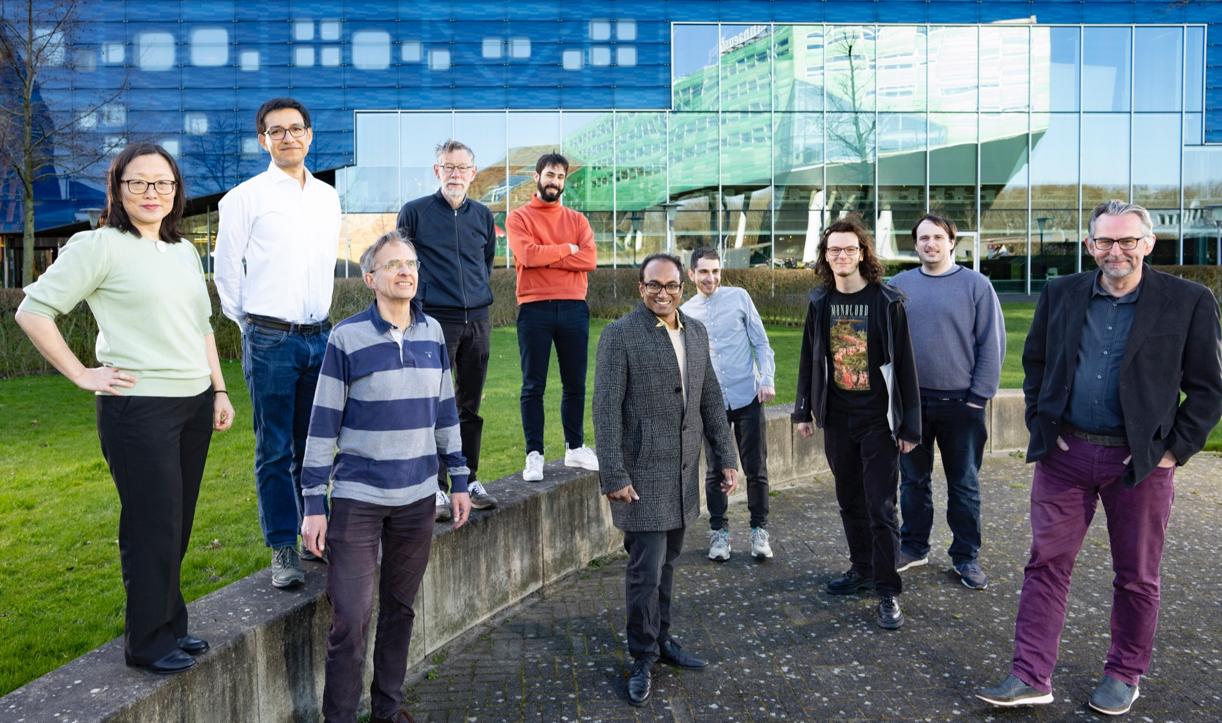
Fundamental Computing
Research Expertise
Logic in Computer Science
Proof Theory
Concurrency Theory
Semantics of Programming Languages
Challenge:
Reliable programs, from theory to practice
Verification techniques (static/dynamic) for message-passing programs
Expressive and practical logical formalisms for verifying state-based systems
Certified concurrent algorithms and programs via mechanized verification
Notes:
1 NWA ORC; 1 Open Competition M; 1 NWO Smart Industry, I Open Competition M2 sustainable software architectures , KDT JU AIMS5.0 AI enabled sustainable Manufacturing and Value Chains, business processes and logistics, healthcare. Feringa Impact Award of Digital Forensics

Slide 9
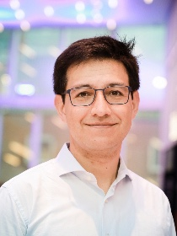
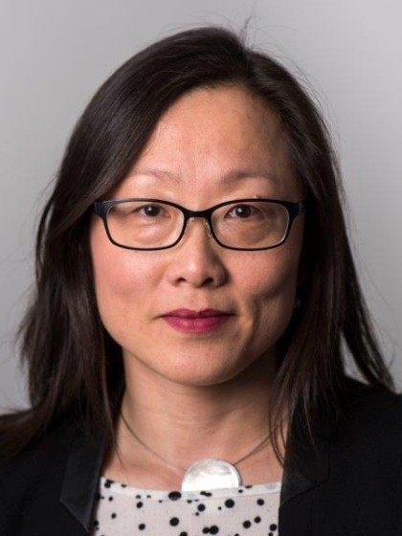
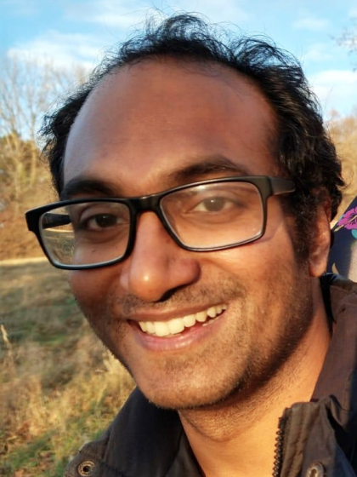
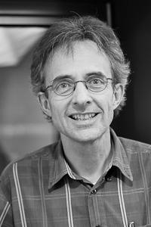
Fundamental Computing
Research Expertise
Logic in Computer Science
Proof Theory
Concurrency Theory
Semantics of Programming Languages
Challenge:
Reliable programs, from theory to practice
Verification techniques (static/dynamic) for message-passing programs
Expressive and practical logical formalisms for verifying state-based systems
Certified concurrent algorithms and programs via mechanized verification
Jorge Pérez
Helle H. Hansen
Revantha Ramanayake
Gerard Renardel de Lavalette (Emeritus)
Notes:
1 NWA ORC; 1 Open Competition M; 1 NWO Smart Industry, I Open Competition M2 sustainable software architectures , KDT JU AIMS5.0 AI enabled sustainable Manufacturing and Value Chains, business processes and logistics, healthcare. Feringa Impact Award of Digital Forensics

Slide 10
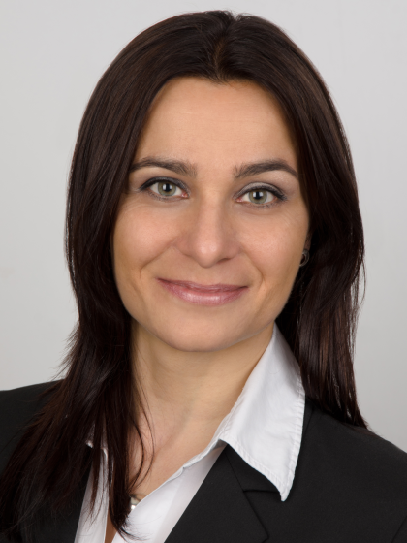
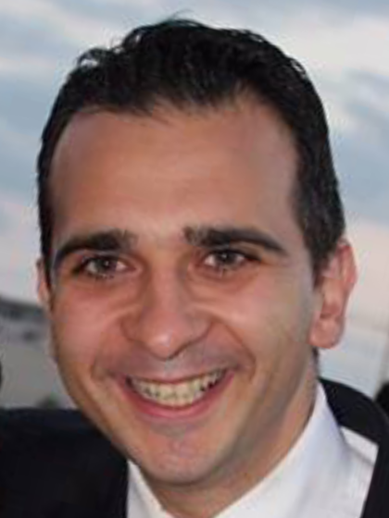
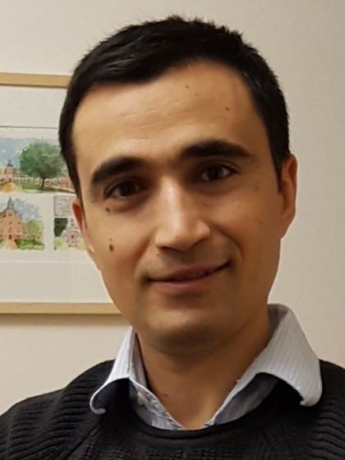
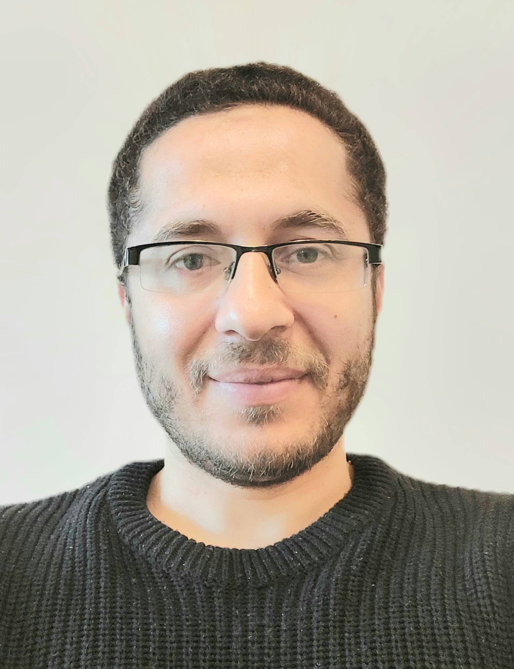
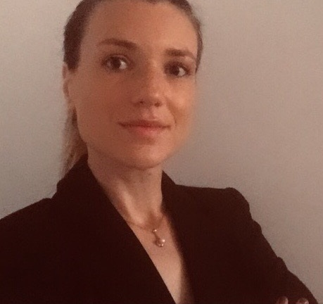
Information Systems
Research areas
Enterprise Information Systems
Process automation and runtime flexibility based on predictive monitoring of KPIs
Adaptive data processing pipelines for large-scale computations
Network science-based analysis of social networks (misinformation), manufacturing processes, provenance data etc.
Information Retrieval and Data Mining
Image processing and brain-inspired techniques, image segmentation and object identification (microscopy, astronomy, fall detection)
Information Assurance and Security
Privacy-preserving techniques (homomorphic encryption, zero-knowledge proofs) – fundamentals and application in genomics
Privacy for Mobile and Web based applications
Dimka
Karastoyanova
George
Azzopardi
Fatih
Turkmen
Fadi
Mohsen
Mirela Riveni
Notes:
1 NWA ORC; 1 Open Competition M; 1 NWO Smart Industry, I Open Competition M2 sustainable software architectures , KDT JU AIMS5.0 AI enabled sustainable Manufacturing and Value Chains, business processes and logistics, healthcare. Feringa Impact Award of Digital Forensics

Slide 11
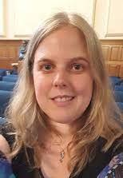
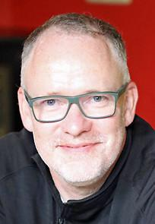
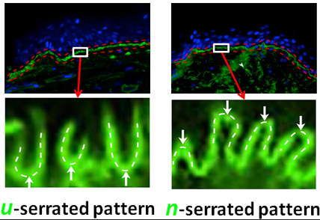
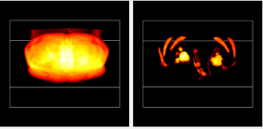
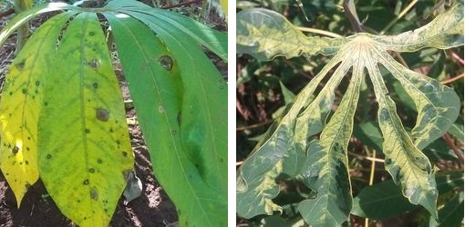
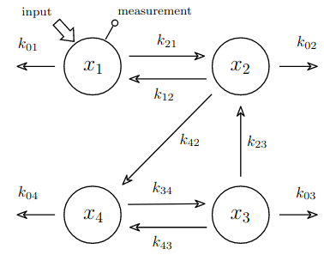
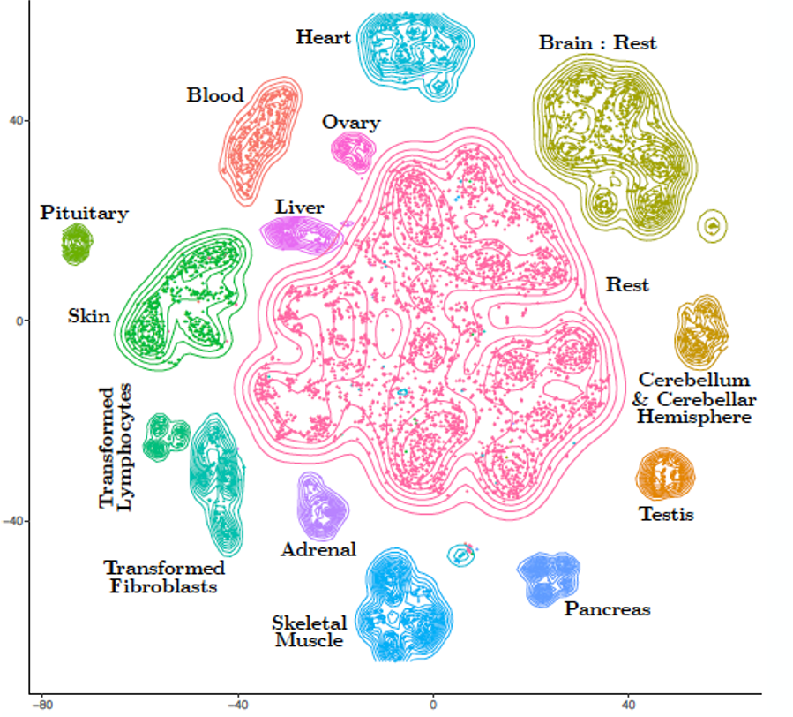
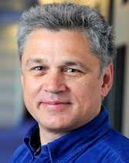
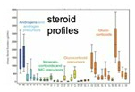
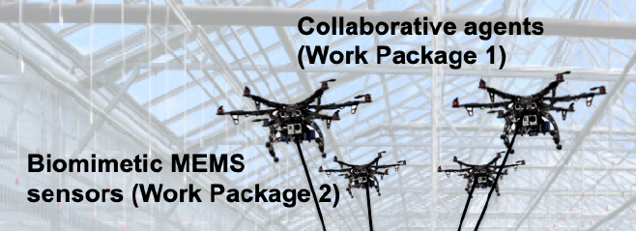
Intelligent Systems
Expertise
Theory of Machine Learning
Model & data driven hybrid methods
Medical image analysis & remote sensing
Mathematical morphology
Interpretable machine learning
Challenge:
Efficient and/or interpretable methods, from theory to practice
Data science (static/dynamic), i.e. Medicine, Astronomy and Engineering
Smart industry
Statistical physics of learning
Learning with limited and multimodal data
Kerstin Bunte
Michael Biehl
Michael Wilkinson
Jiapan Guo
Nicolai Petkov (emeritus)
Notes:
1 NWA ORC; 1 Open Competition M; 1 NWO Smart Industry, I Open Competition M2 sustainable software architectures , KDT JU AIMS5.0 AI enabled sustainable Manufacturing and Value Chains, business processes and logistics, healthcare. Feringa Impact Award of Digital Forensics

Slide 12
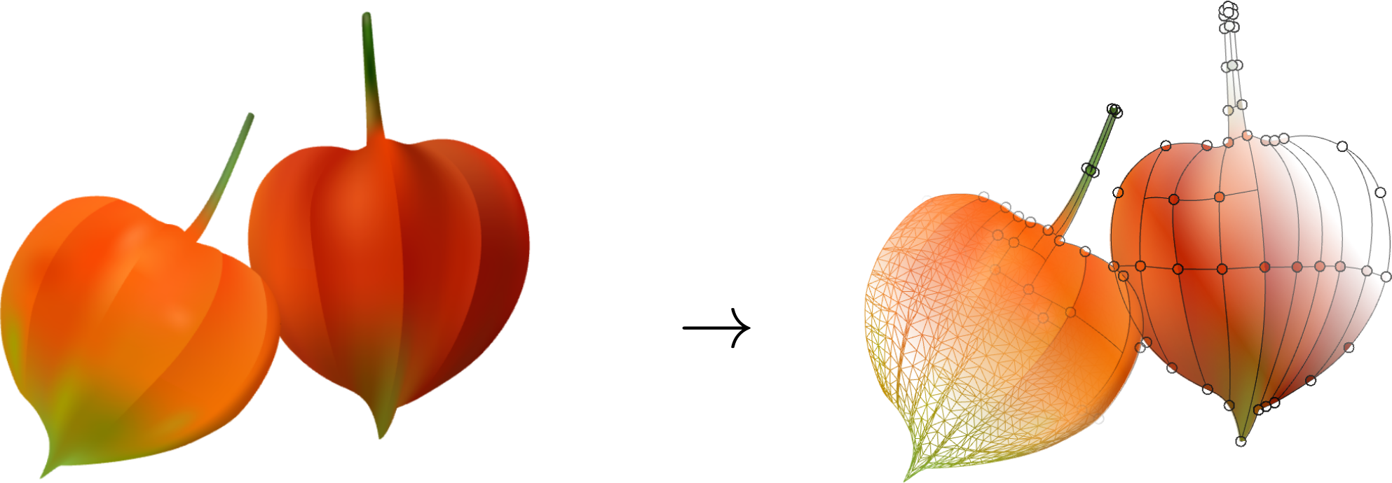
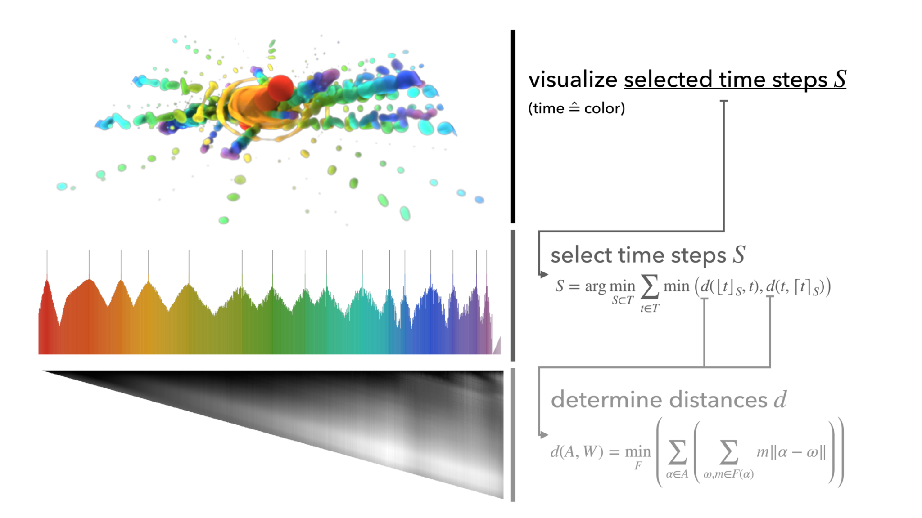
Scientific Visualization and Computer Graphics
Challenges
raster
vector
- Image vectorization (fully scalable, sparse, easy to edit)
- Optimization of scientific large data visualization
- Perceptually optimized display systems
Jiří Kosinka
Steffen Frey
General topics and interests
- Shape and image modelling and processing
- Big data and high-performance visualisation
- Optimization and machine learning
- Visual perception
- VR/AR display technology, eye tracking
- Data-driven method & system configuration
- Computer aided design and analysis
- Medical data, astronomy, …
Cara Tursun
Notes:
1 NWA ORC; 1 Open Competition M; 1 NWO Smart Industry, I Open Competition M2 sustainable software architectures , KDT JU AIMS5.0 AI enabled sustainable Manufacturing and Value Chains, business processes and logistics, healthcare. Feringa Impact Award of Digital Forensics

Slide 13
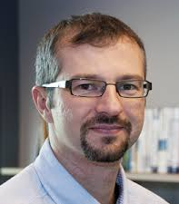
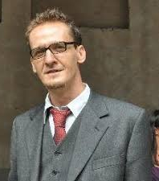
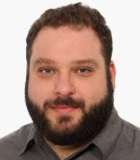
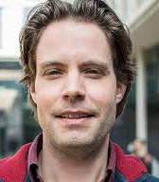
Software Engineering and Architecture
Paris Avgeriou
Andrea Capiluppi
Vasilios
Andrikopoulos
Ayushi Rastogi
Daniel Feitosa
Tijs van der Storm
Research Profile
With industry
Evidence-based
Tools, tools, tools
High-tech systems, IoT, SoS
Cloud-based & serverless
SE 4 AI
Challenges
Architecting Large, Complex & Long-lived Systems
Making better software teams, software, and society
Bridging Source Code and Architecture
Better languages for more effective software engineering
Building Sustainable Cloud-based Software
Continuous Maintenance with Industry
Notes:
1 NWA ORC; 1 Open Competition M; 1 NWO Smart Industry, I Open Competition M2 sustainable software architectures , KDT JU AIMS5.0 AI enabled sustainable Manufacturing and Value Chains, business processes and logistics, healthcare. Feringa Impact Award of Digital Forensics

